Slide 1
FBP in FBP
VSH and Grash

Slide 2
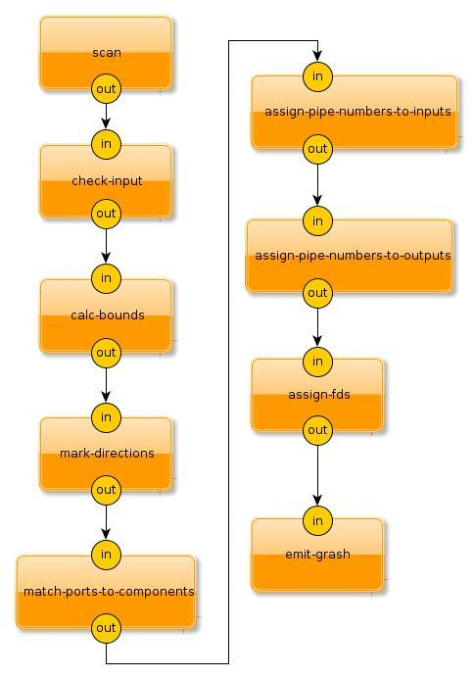
Tools...
yEd diagram editor
some conventions
factbase + queries
homemade interpreter

Slide 3
yEd
Graph editor
Emits .graphml (XML)
Edges between diagram objects

Slide 4
Some Conventions
Arbitrarily chosen
Modern Nodes Bevel Node represents components
Shape Node Ellipse represents ports
Edge Types Polyline with Target Arrow represents wires (flows)

Slide 5
Some Conventions (2)
Ports belong to components they intersect
Standard port names “in”, “out” and “err” (other names possible in future)
Component name represents program name
Diagram will be compiled into a shell-like chain of forked programs using pipes & dup2()

Slide 6
Factbase & Queries
Triples (Web 3.0)
(<predicate> <subject> <object>)
Could use Prolog
Cheap implementation: hash table of hash tables indexed by <subject>

Slide 7
Factbase & Queries (2)
Queries insert new facts into factbase stream
(cheap) Queries implemented using loops
e.g.
for every node n in FB
when kind(n) is “port”
if direction(n) is “sink”
do-something(n)

Slide 8
Homemade Interpreter
8 commands
comment #...\n
pipe <n> - creates n pipes starting at 0
push <n> - push n as arg on TOS
dup <n> - dup2(pipes[TOS][TOS-1],n), pop, pop
exec <args> - split args, close pipes, execvp

Slide 9
Homemade Interpreter (2)
exec1st <args> - same as exec, but appends args from cmd line
fork - fork a new process ; parent ignores all subsequent commands up to krof
krof - end of forked child section ; parent resumes processing commands ; child either execs or terminates

Slide 10
Fork/Pipe (parent reads child’s output)
int pipefd[2]; pipe(pipefd); if (fork() == 0) { close(pipefd[0]); // close reading end in the child dup2(pipefd[1], 1); // send stdout to the pipe dup2(pipefd[1], 2); // send stderr to the pipe close(pipefd[1]); // this descriptor is no longer needed exec(...); } else { // parent char buffer[1024]; close(pipefd[1]); // close the write end of the pipe in the parent while (read(pipefd[0], buffer, sizeof(buffer)) != 0) { } }

Slide 11
.graphml for one component
<node id="n0">
<data key="d6">
<y:GenericNode configuration="BevelNode3">
<y:Geometry height="77.0" width="137.0" x="-176.5" y="-224.0"/>
<y:Fill color="#FF9900" transparent="false"/>
<y:BorderStyle hasColor="false" type="line" width="1.0"/>
<y:NodeLabel alignment="center" autoSizePolicy="content" fontFamily="Dialog" fontSize="12" fontStyle="plain" hasBackgroundColor="false" hasLineColor="false" height="17.962890625" modelName="custom" textColor="#000000" visible="true" width="30.337890625" x="53.3310546875" y="29.5185546875">scan<y:LabelModel>
<y:SmartNodeLabelModel distance="4.0"/>
</y:LabelModel>
<y:ModelParameter>
<y:SmartNodeLabelModelParameter labelRatioX="0.0" labelRatioY="0.0" nodeRatioX="0.0" nodeRatioY="0.0" offsetX="0.0" offsetY="0.0" upX="0.0" upY="-1.0"/>
</y:ModelParameter>
</y:NodeLabel>
</y:GenericNode>
</data>
</node>

Slide 12
Step 1: Scan
Use XML parser to read .graphml
Extract graphical info and create factbase
facts (predicates): component, node, type, geometry, kind, portName, edge, source, sink, quit

Slide 13
FB Snippet “assign-fds” after Scan
…
(node n22 nil)
(type n22 box)
(geometry n22 (39.5 125.0 137.0 77.0))
(kind n22 "assign-fds")
(node n23 nil)
(type n23 port)
(geometry n23 (93.0 115.0 30.0 30.0))
(portName n23 "in")
(node n24 nil)
...

Slide 14
Step 2: Check-input
input check
checks legality of generated FB
doesn’t add any new facts

Slide 15
Step 3: Calc-bounds
Calculates bounding box for all nodes
...
(NODE N22 NIL)
(TYPE N22 BOX)
(GEOMETRY N22 (39.5 125.0 137.0 77.0))
(KIND N22 "assign-fds")
(BOUNDS N22 (39.5 125.0 176.5 202.0))
...

Slide 16
Step 4: Mark-Directions
Direction for each port (in=sink, out=source)
…
(TYPE N23 PORT)
(GEOMETRY N23 (93.0 115.0 30.0 30.0))
(PORTNAME N23 "in")
(BOUNDS N23 (93.0 115.0 123.0 145.0))
(SINK N23 NIL)
(edge e5 nil) ←from Step 1
(source e5 n21) ←from Step 1
(sink e5 n23) ←from Step 1
...

Slide 17
Step 5: Match Ports to Components
Find ports that intersect boxes and associate them with the boxes
For every node(n) in FB
if kind(n) is “port”
for every node(c) in FB
if kind(c) is “box”
if bounding-box(n) intersects bounding-box(c)
insert fact (parent n c)
augment fact ({input|output} c (n …))
Components can have multiple inputs/outputs, keep them on a list

Slide 18
Step 6: Assign Pipe No.’s to Inputs
Find every input port, give it a unique number
set next-pipe-number to 0
for every node(n) in FB
if type(n) is “port” and sink(n)
inc next-pipe-number
insert fact (pipe-num n next-pipe-number)

Slide 19
Step 7: Assign Pipe No.’s to Outputs
Find all output ports, give them their corresponding input’s pipe number
for every node(n) in FB
if type(n) is “port” and source(n)
for every edge(e) in FB
find sink(i) which is attached to n
add fact (pipe-num n i.pipe-num)
FBP specifies that multiple outputs can connect to an input

Slide 20
Step 8: Assign FD’s
Assign a file descriptor to each port, using unix convention “in” is 0, “out” is 1, “err” is 2, (others >3)
(source-fds <id> ((pipe . fd) (pipe . fd) ...))
(sink-fds <id> ((pipe . fd) (pipe . fd) ...))

Slide 21
Step 9: Emit Grash
1. emit “#<filename>”
2. emit “pipes <n-pipes>”
3. for every component
emit “fork”
for every sink of component
emit “push 0” “push <pipe-num>” “dup <fd>”
for every source of component
emit “push 1” “push <pipe-num>” “dup <fd>”
emit “exec” or “exec1st” (if no inputs) <exec-line>
emit “krof”

Slide 22
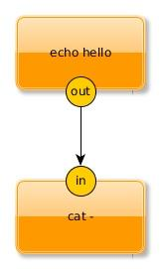
Example

Slide 23
Step 8: Before emit-grash
(COMPONENT "echo-cat" NIL)
(N-PIPES "echo-cat" 1)
(NODE N0 NIL)
(TYPE N0 BOX)
(GEOMETRY N0 (250.5 104.0 131.0 76.0))
(KIND N0 "echo hello")
(BOUNDS N0 (250.5 104.0 381.5 180.0))
(OUTPUT N0 (N2))
(SOURCE-FDS N0 ((0 . 1)))
(NODE N1 NIL)
(TYPE N1 BOX)
(GEOMETRY N1 (250.5 269.0 131.0 76.0))
(KIND N1 "cat -")
(BOUNDS N1 (250.5 269.0 381.5 345.0))
(INPUT N1 (N3))
(SINK-FDS N1 ((0 . 0)))

Slide 24
Step 8: Before emit-grash(2)
(NODE N2 NIL)
(TYPE N2 PORT)
(GEOMETRY N2 (301.0 166.0 30.0 30.0))
(PORTNAME N2 "out")
(BOUNDS N2 (301.0 166.0 331.0 196.0))
(SOURCE N2 NIL)
(PARENT N2 N0)
(PIPE-NUM N2 0)
(FD-NUM N2 1)
(NODE N3 NIL)
(TYPE N3 PORT)
(GEOMETRY N3 (301.0 256.0 30.0 30.0))
(PORTNAME N3 "in")
(BOUNDS N3 (301.0 256.0 331.0 286.0))
(SINK N3 NIL)

Slide 25
Step 8: Before emit-grash(3)
(PARENT N3 N1)
(PIPE-NUM N3 0)
(FD-NUM N3 0)
(EDGE E0 NIL)
(SOURCE E0 N2)
(SINK E0 N3)
;;
(quit nil nil)

Slide 26
Example: Grash output
#name echo-cat.gsh
pipes 1
fork
push 1
push 0
dup 1
exec1st echo hello
krof
fork
push 0
push 0
dup 0
exec cat -
krof

Slide 27
Conclusion
every step is small and easy to understand
maintainability, understandability
any diagram editor that emits XML could have been used
edge begin and end points could also have been inferred from geometry

Slide 28
Conclusion(2)
diagrams = a new syntax for DSL’s
emitters for any language with ports (eg. GO, CSP, Erlang, etc)
emitters for any language with threads and mailboxes
emitters for any language with coroutines (js, python, lua, etc)

Slide 29
https://github.com/guitarvydas/vsh

